Slide 1

ABAP RAP – Managed with Wrapper scenario and “unmanaged save”

Slide 2
Wrapper Scenario
Incl. unmanaged Save

Slide 3
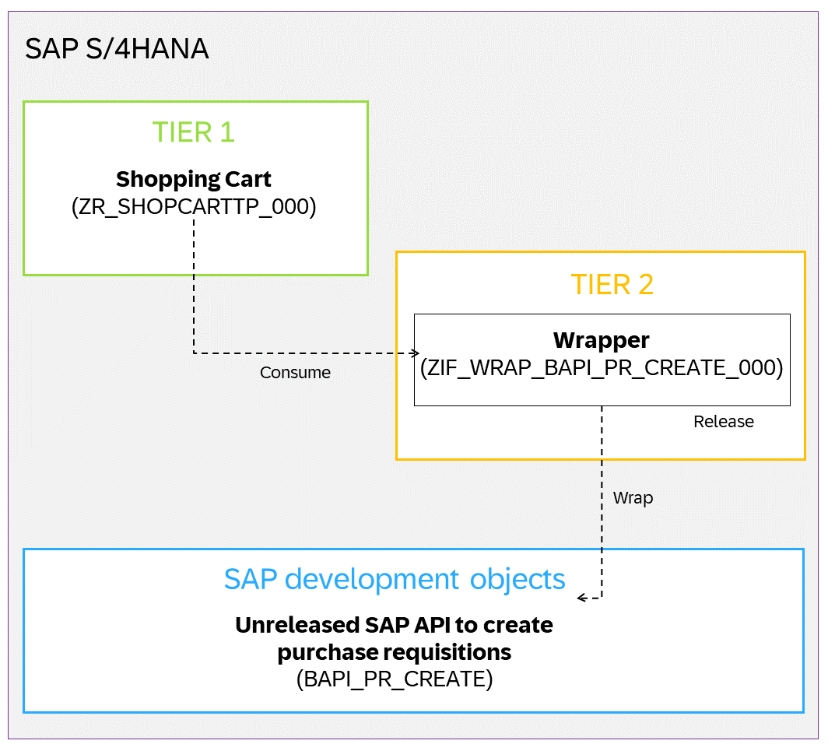
Wrapper Scenario

Slide 4
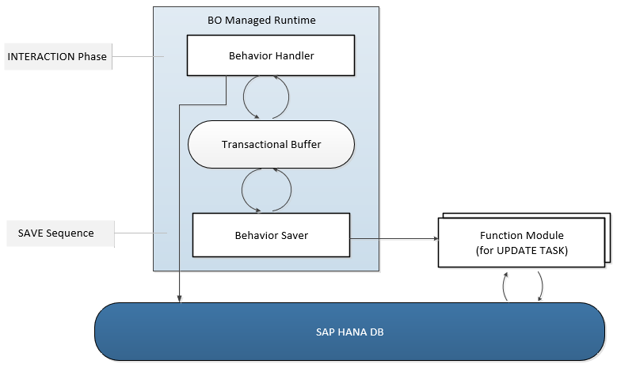
Runtime for the Managed Business Objects with Unmanaged Save

Slide 5
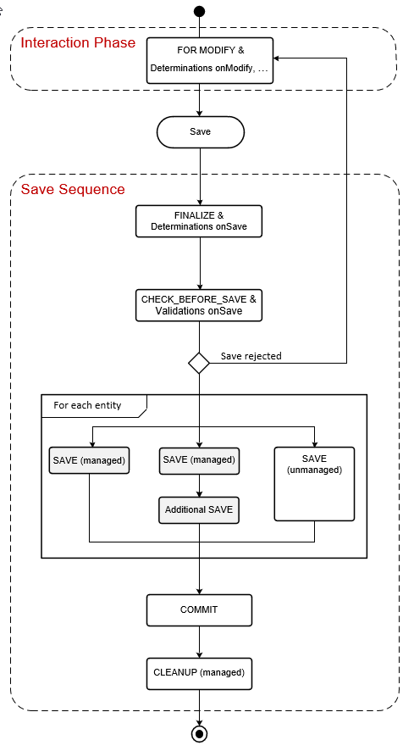
Unmanaged Save within the Transactional Processing

Slide 6
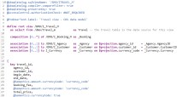
Implementation Workflow
1
Create Wrapper Interface
2
Create Wrapper Class
3
Create Wrapper Factory Class
4
Set Release for Tier 2
5
Create DB Tables
6
7
8
Create CDS Views
Create Behaviour Definition
Create Behaviour Projection

Slide 7
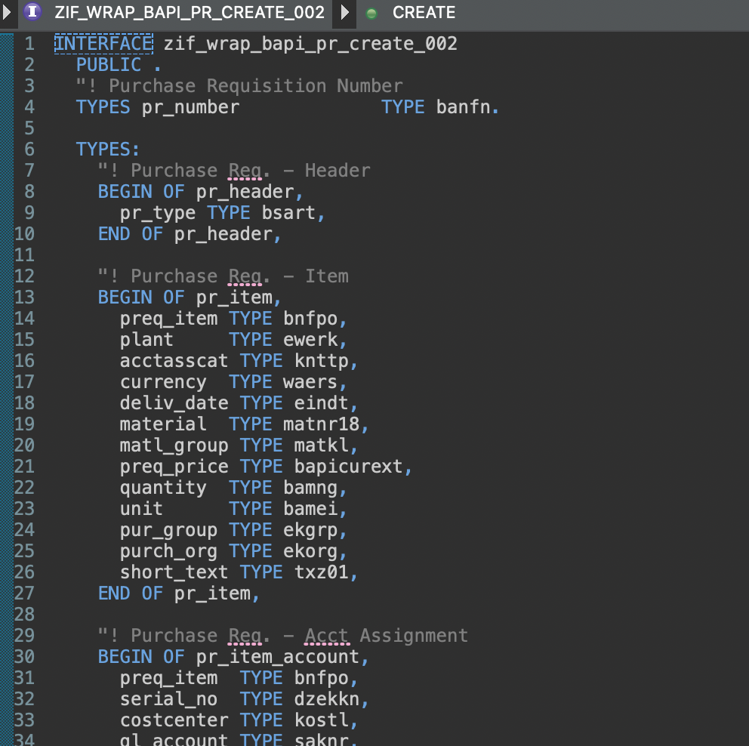
Create an Interface

Slide 8
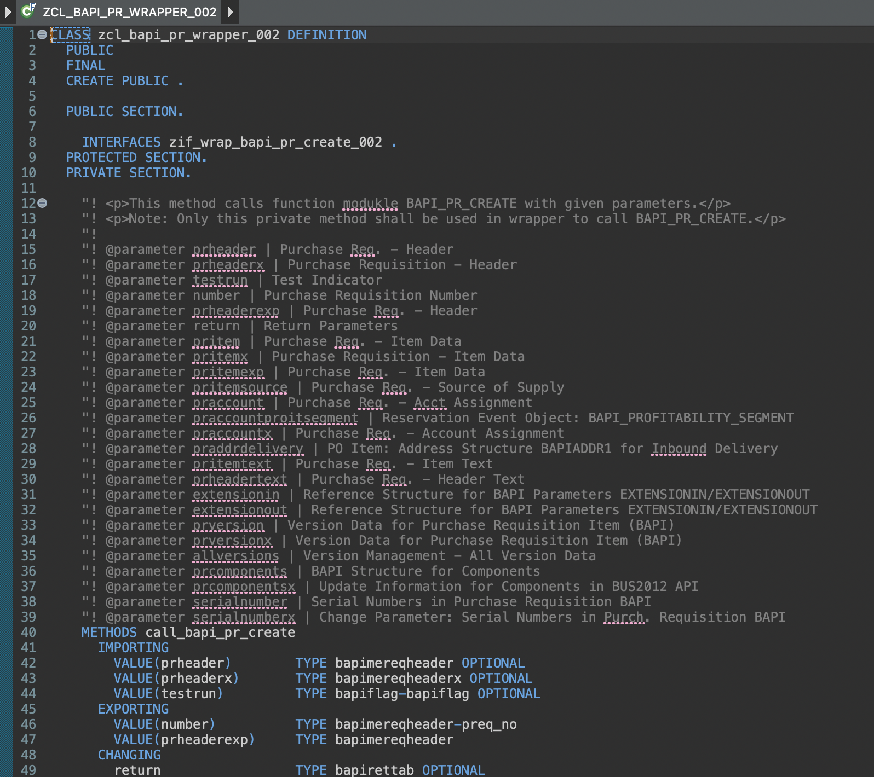
Create a Wrapper Class
To wrap the BAPI call

Slide 9
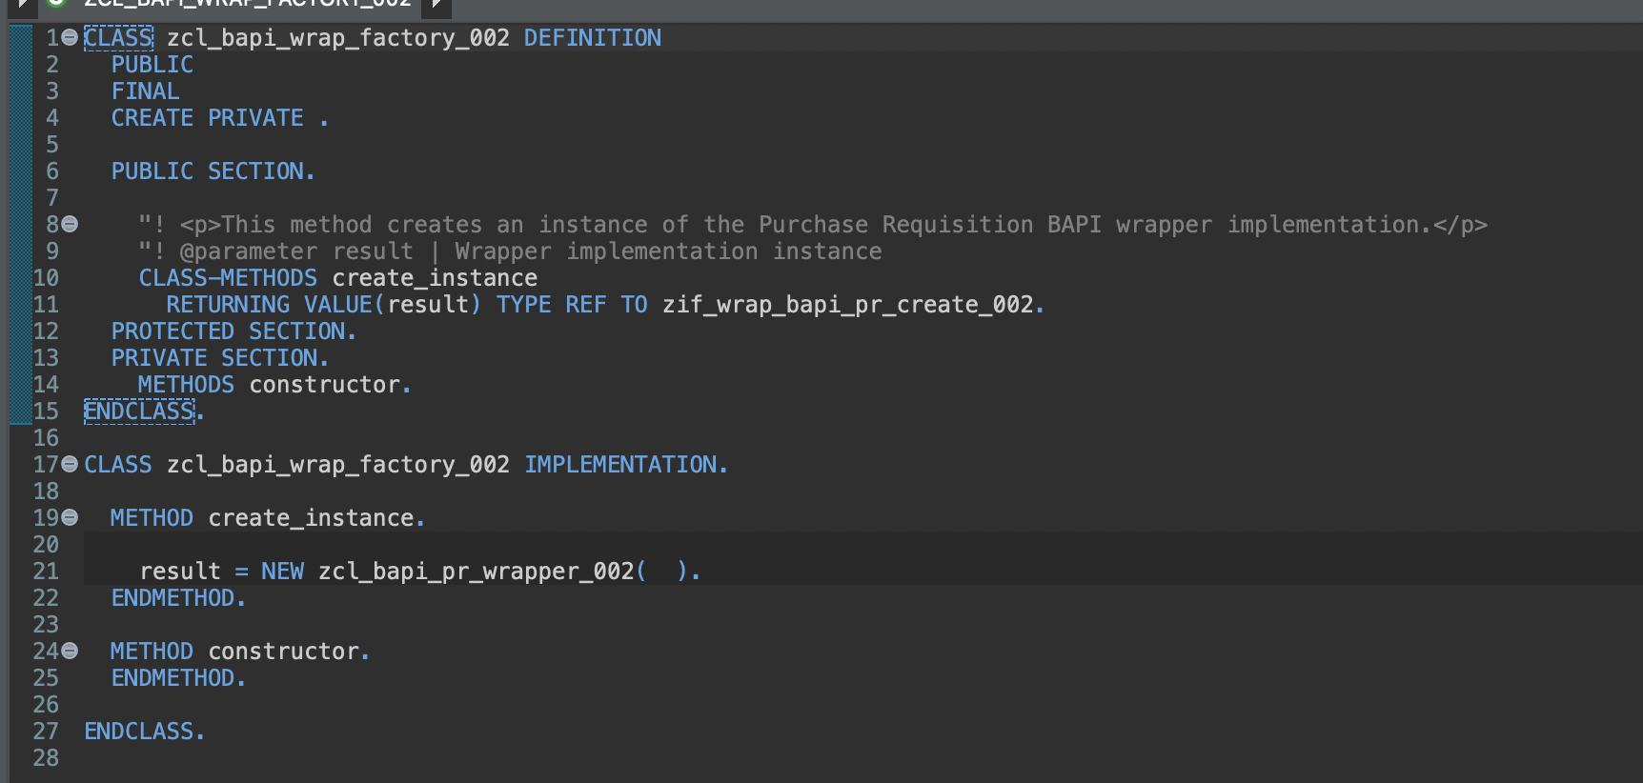
Create a Factory Class

Slide 10
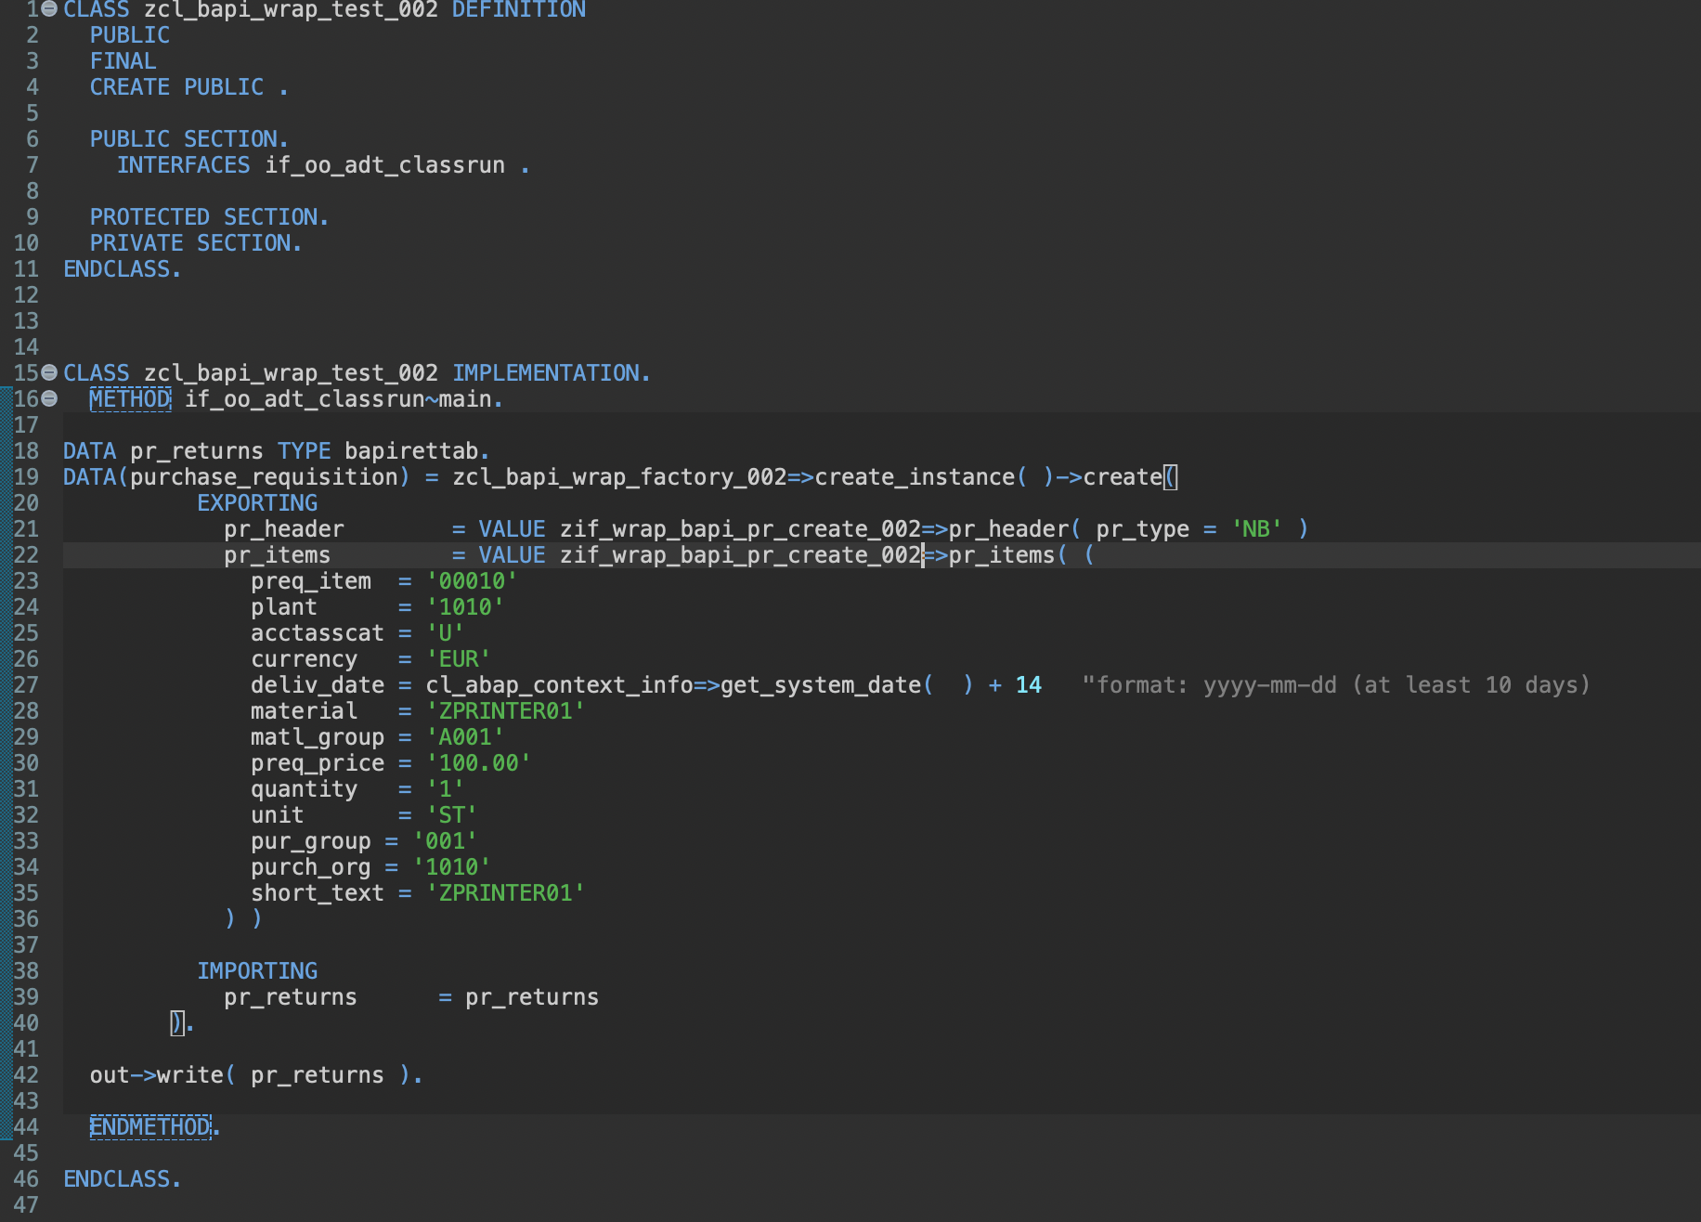
Implement a Test Class
With the test class we test if a call to the wrapper class correctly executes the BAPI call
Set the correct parameters for the system
Use CDS Views (i.e. I_Product) to determine the correct data.

Slide 11
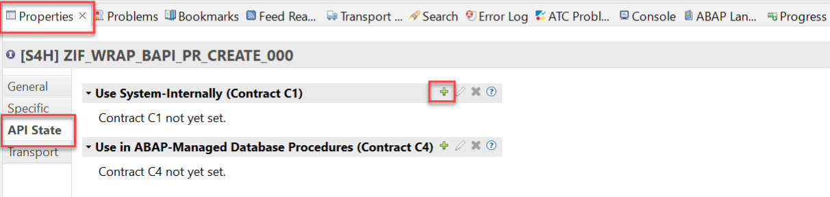
Set Release State for Tier 1
Set the correct Release State for the Wrapper Factory Class and the Wrapper Interface (C1).

Slide 12
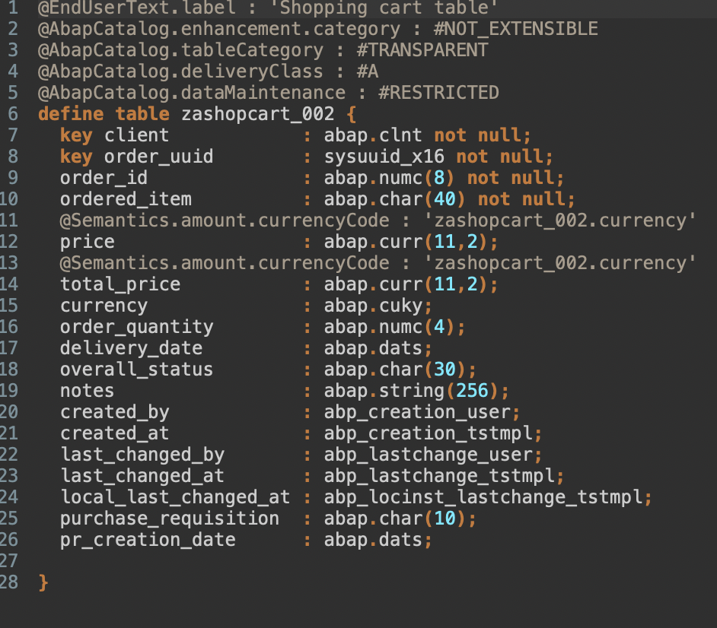
Create DB tables

Slide 13
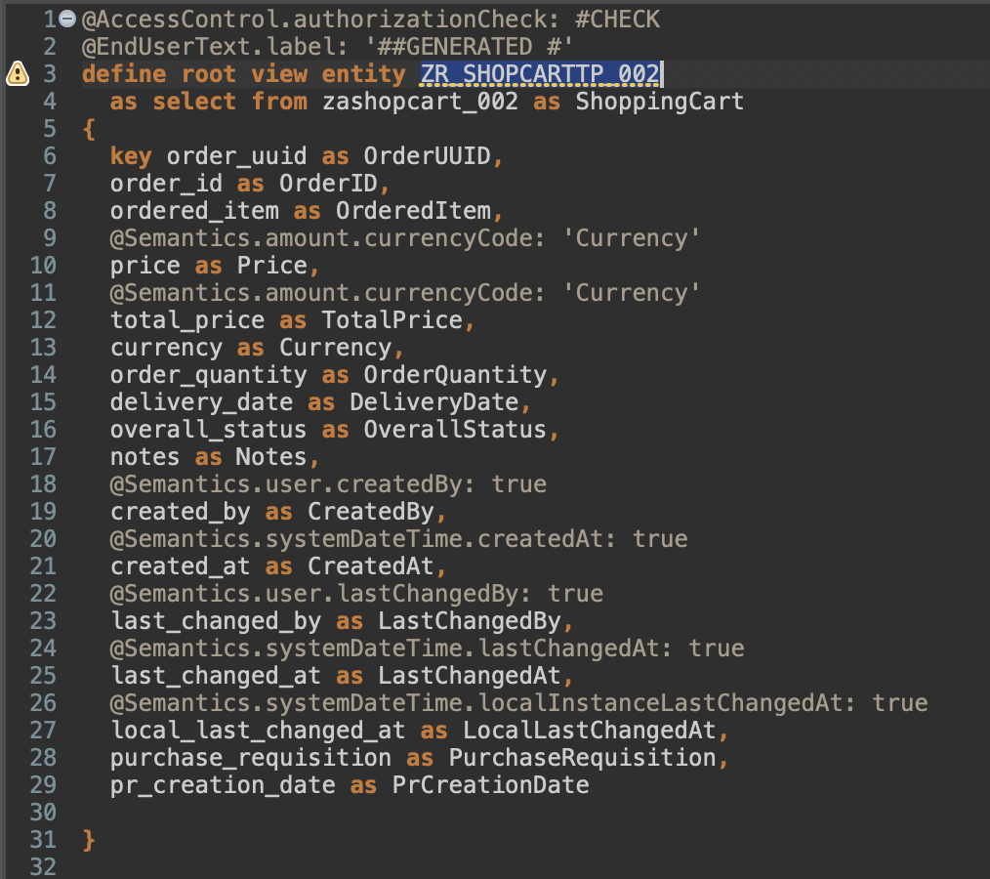
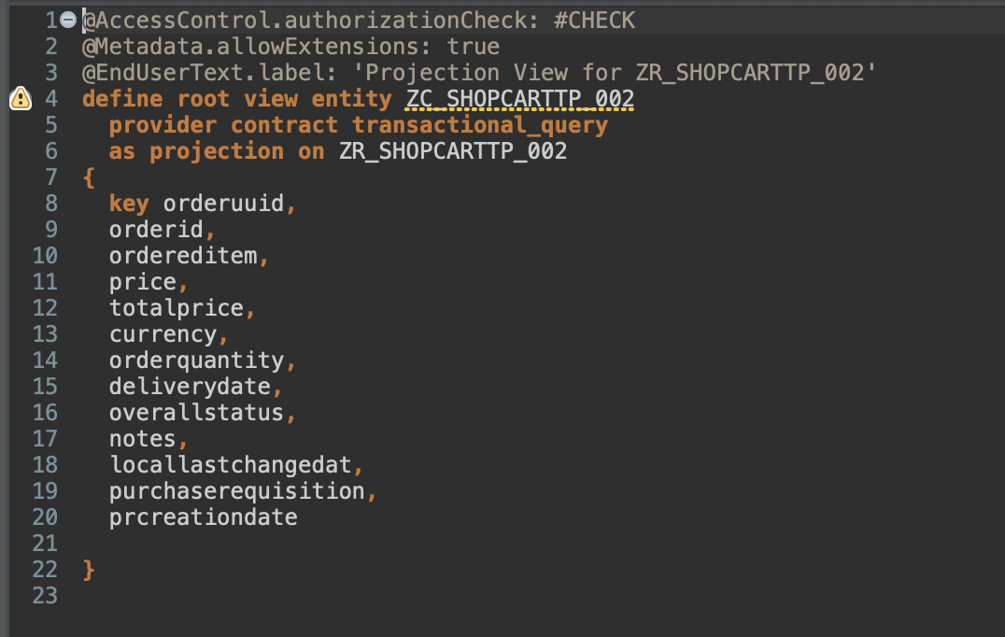
Create the CDS View entities
CDS Interface view entity
CDS Projection view entity

Slide 14
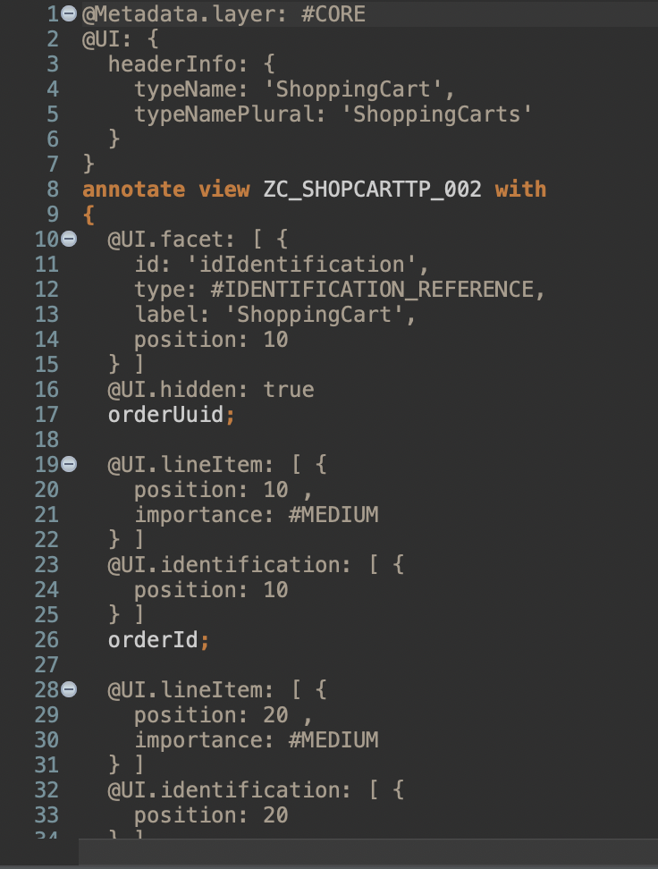
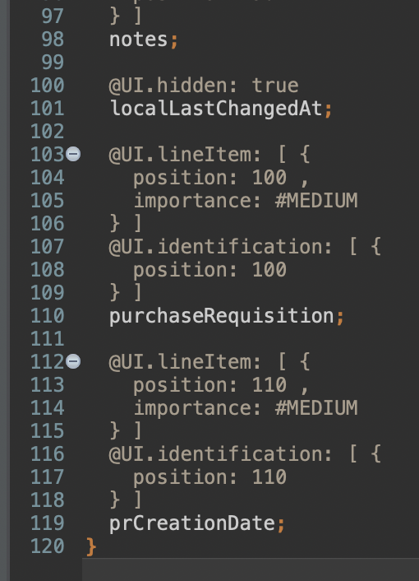
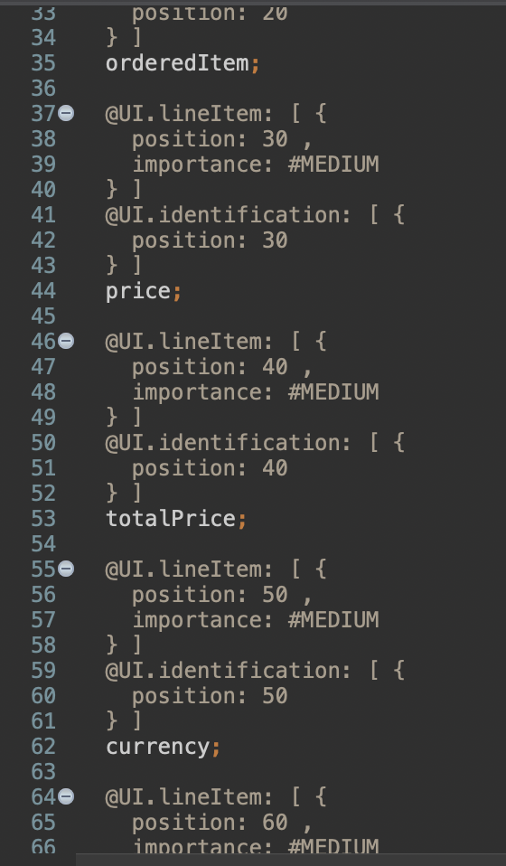
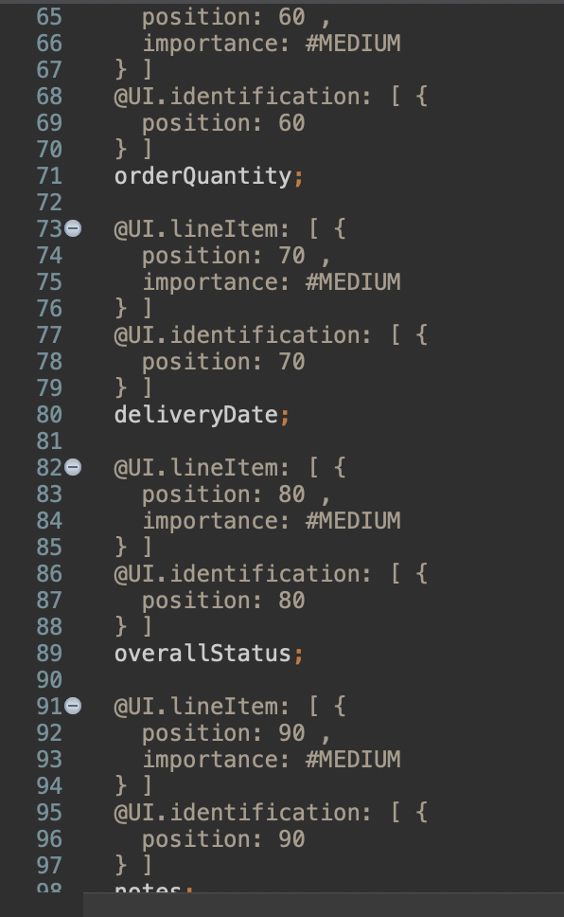
Create a Metadata Extension

Slide 15
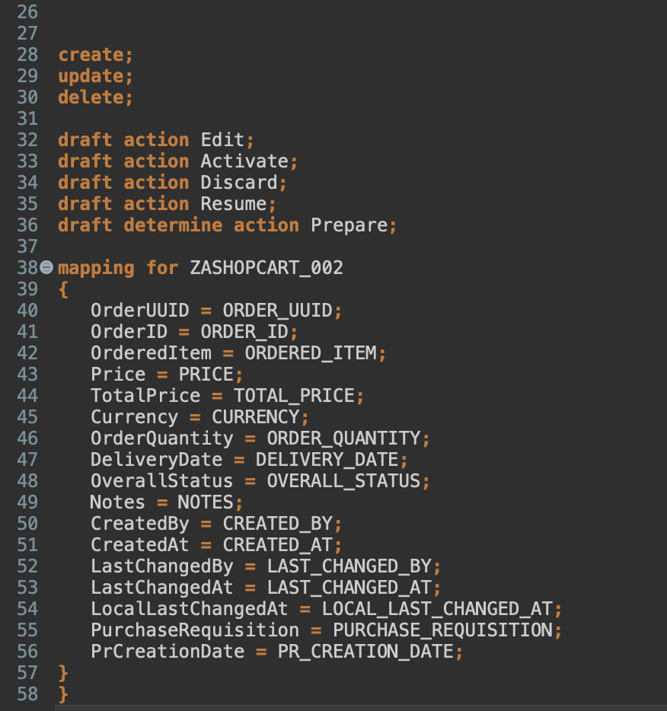
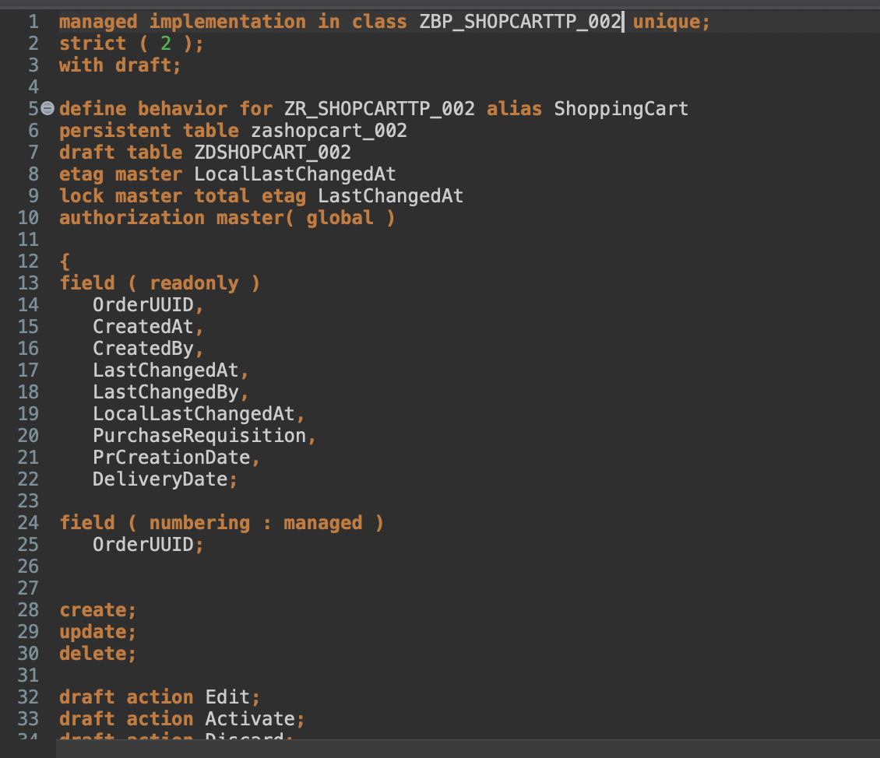
Create Behaviour Definition

Slide 16
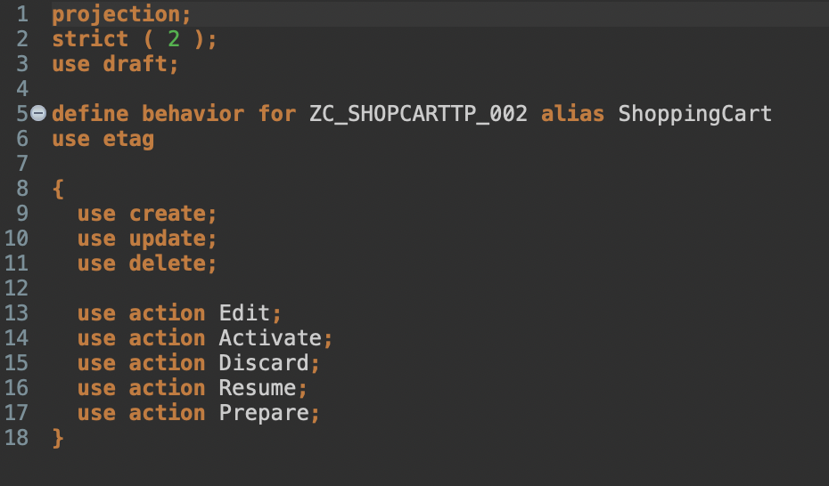
Create Behavior Projection

Slide 17
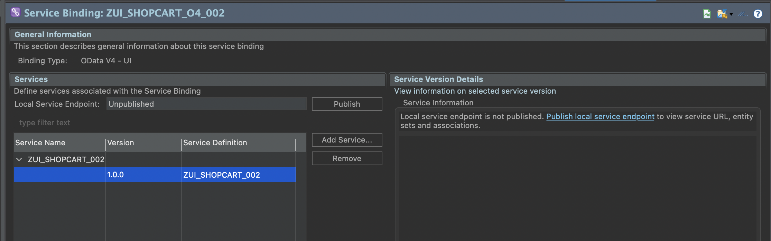
Create Service Definition and Binding / Publish it
/IWFND/V4_ADMIN

Slide 18

Test it
If Metadata (Annotations) are missing, add them.

Slide 19
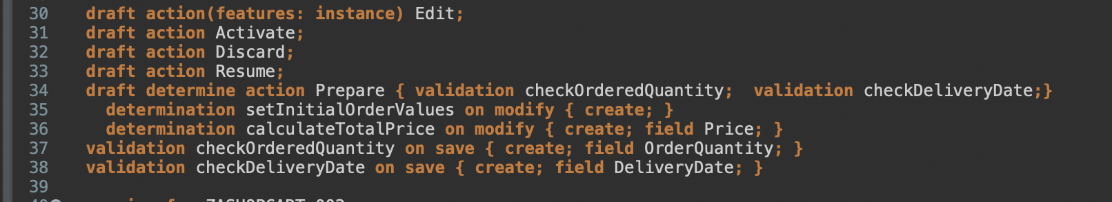
Extend the Behavior definition

Slide 20
Data definition for Products (Value Help)
Lege eine Value Help an: ZI_PRODUCTS_### für Produkte selektiert von I_PRODUCT
Fields
Product
ProductGroup
BaseUnit
Zusatzaufgabe: Füge Preise hinzu.

Slide 21
Extend the Metadata
@Consumption.valueHelpDefinition: [{ entity: {name: 'ZI_PRODUCTS_###' , element: 'ProductText' }, additionalBinding: [{ localElement: 'price', element: 'Price', usage: #RESULT }, { localElement: 'currency', element: 'Currency', usage: #RESULT } ] }]
Annotation for field ordereditem;

Slide 22
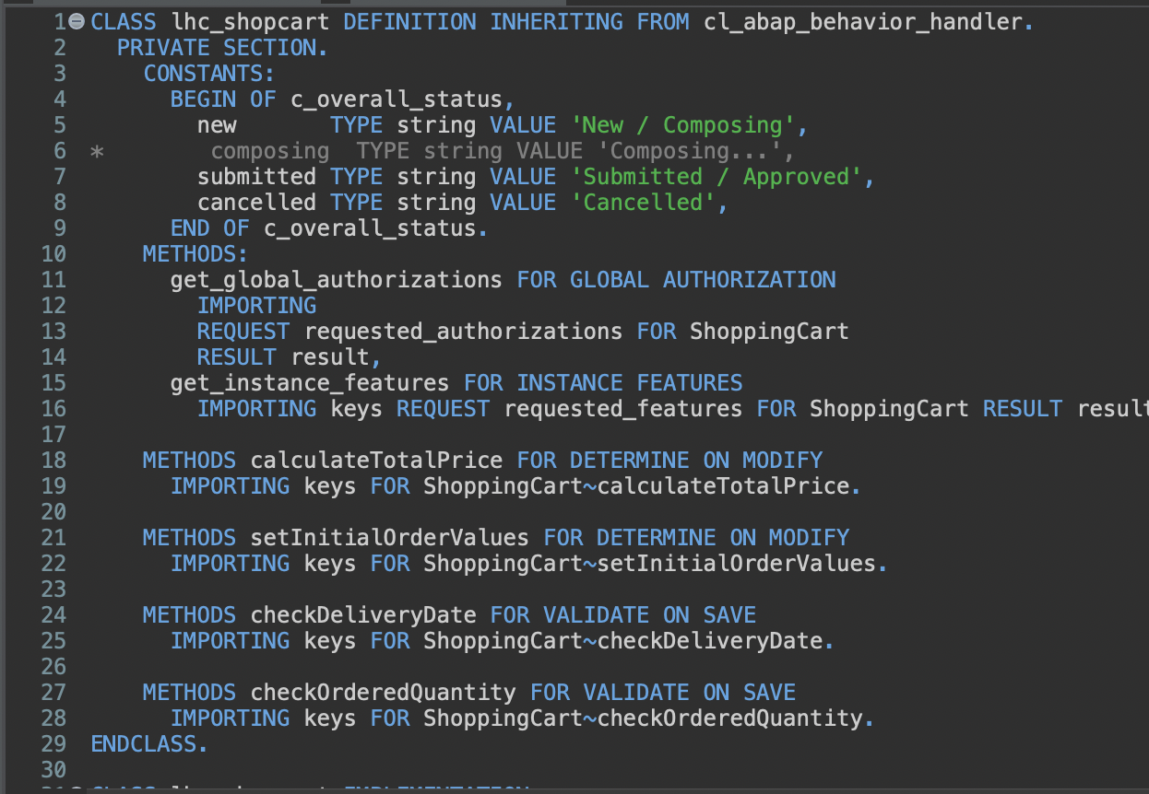
Create the Behaviour implementation

Slide 23
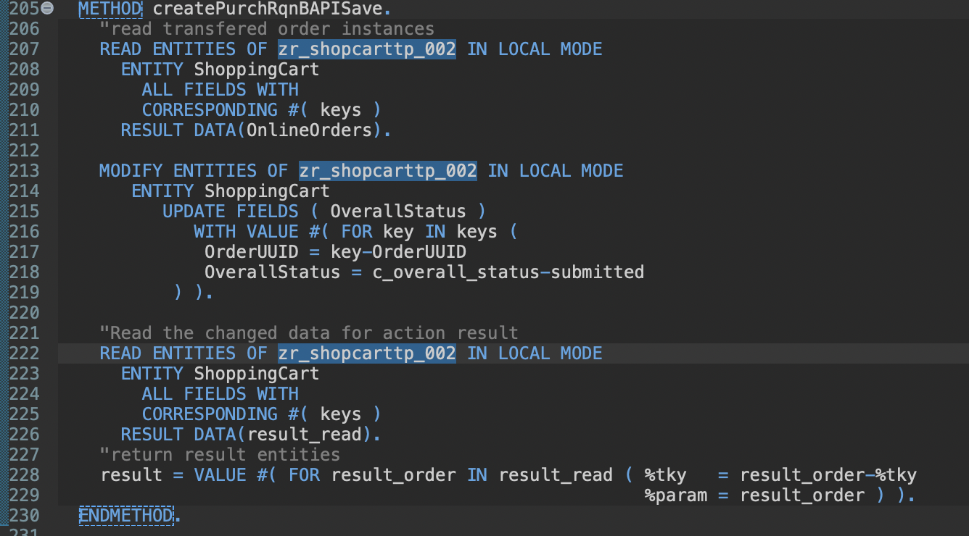
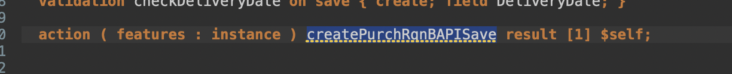
Implement the action “createPurchRqnBAPISave”

Slide 24
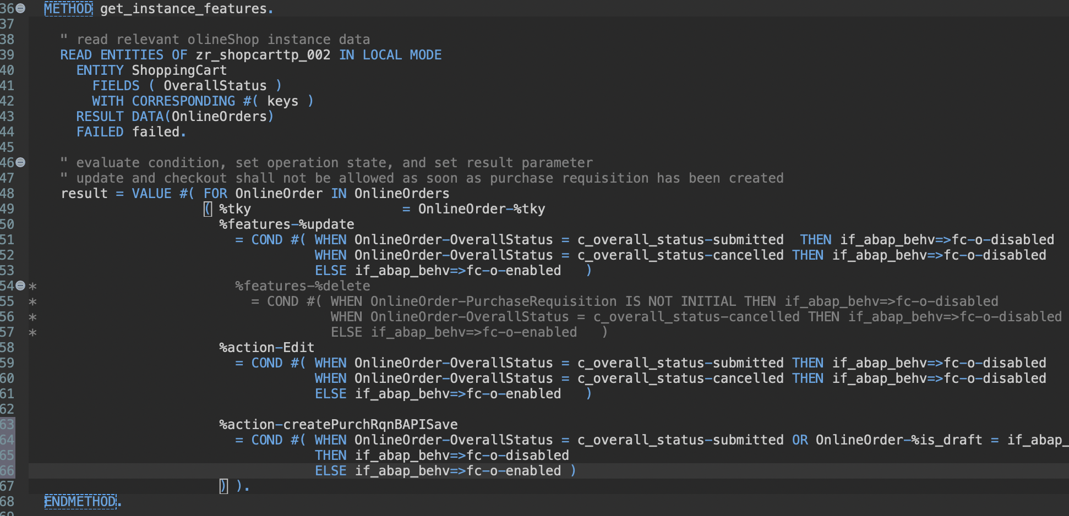
Implement the Action „createPurchRqnBAPISave“
Change get_instance_features with createPurchRqnBAPISave

Slide 25
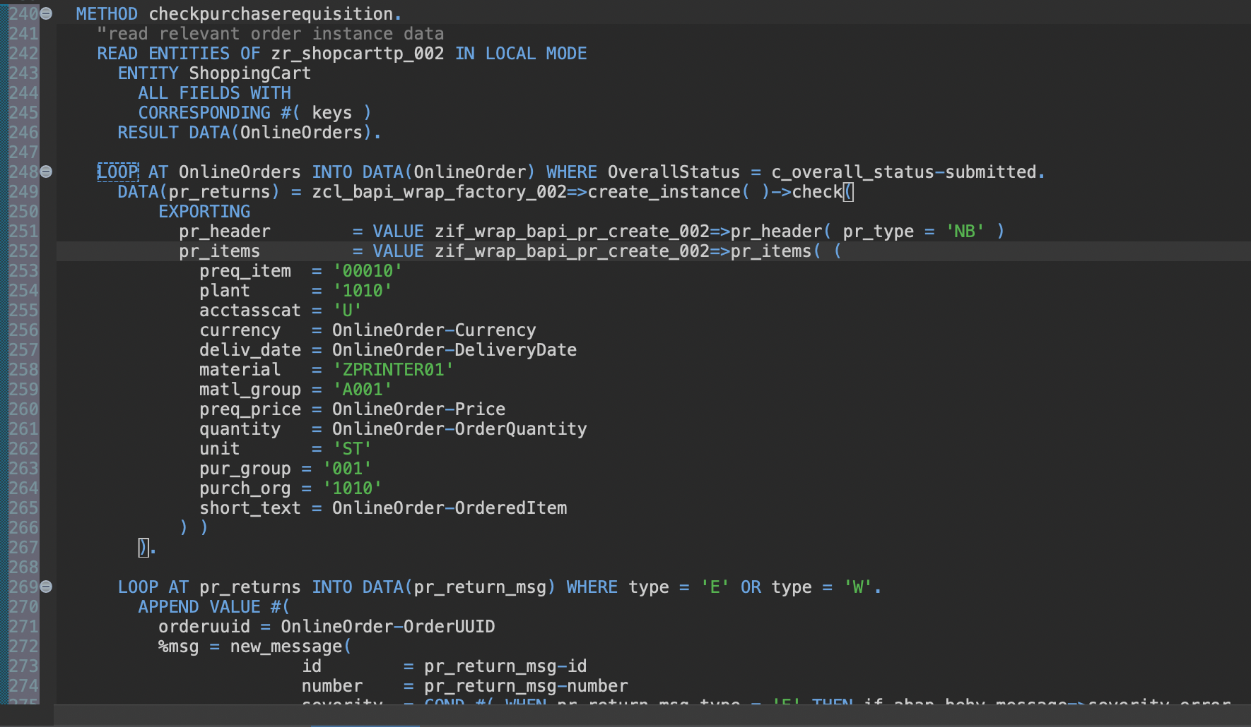
Implement „on save validation“ with BAPI Test Mode

Slide 26
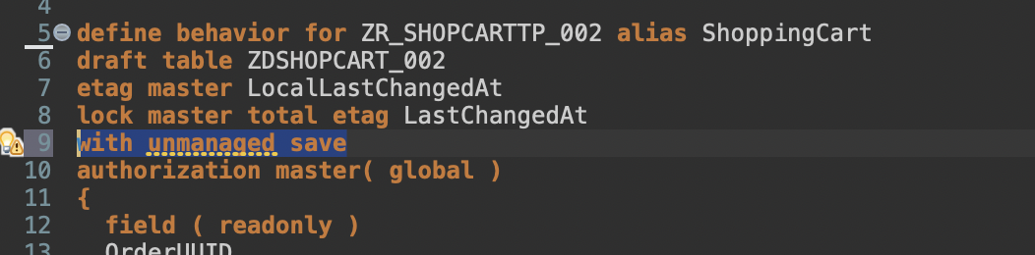
Implement the „unmanaged“ save - 1
Add with unmanaged save
Delete persistent table zashopcart_002
Persistent tables are not working with unmanaged

Slide 27
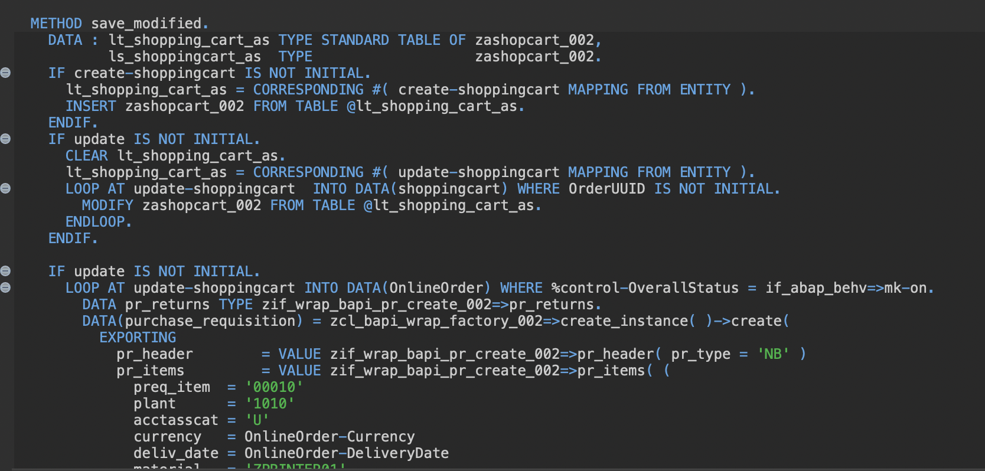
Implement “unmanaged save” - 2

Slide 28
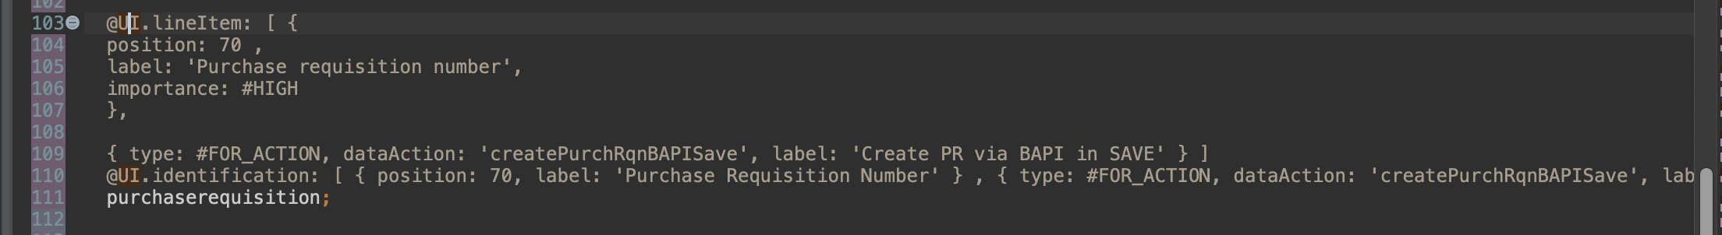
Define the new Action in Metadata

Slide 29
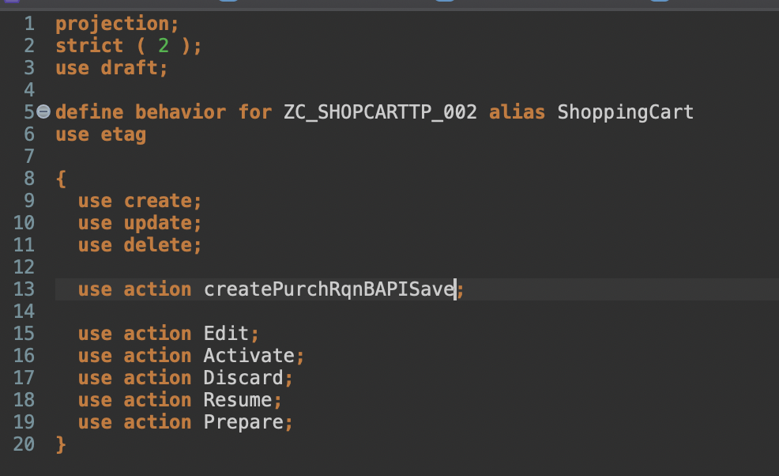
Add the Action

Slide 30
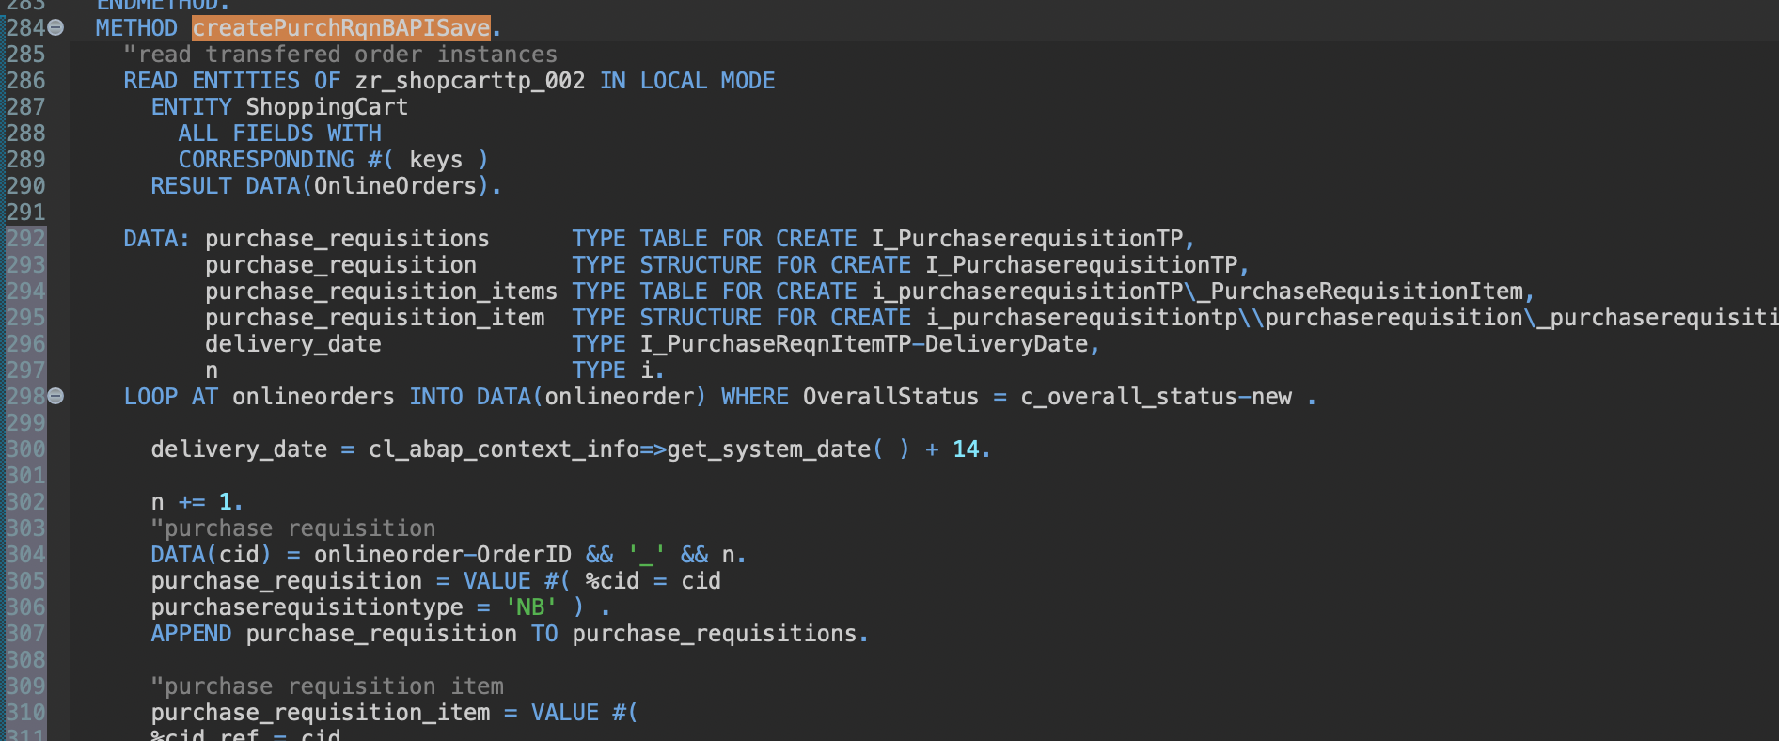
Change Wrapper against released API
Dupliziere die Behavior Klasse, um beide Codings zu erhalten.
Info: Aktiviere erst, wenn die API komplett eingebaut ist.

Slide 31
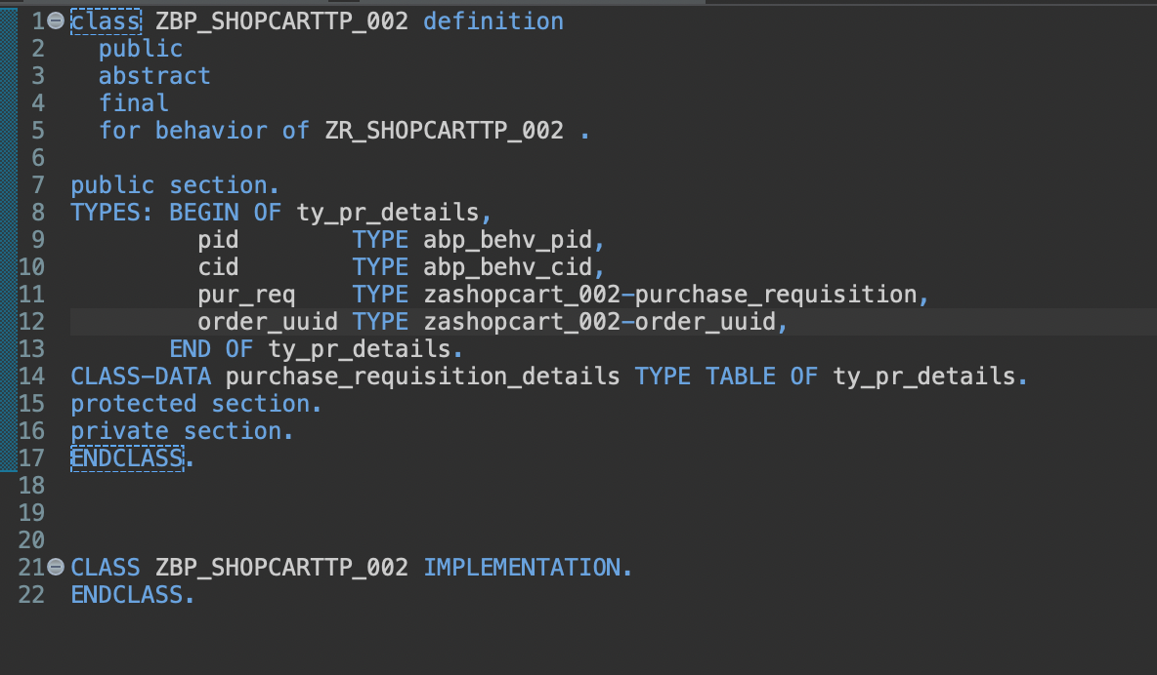
Change Wrapper against the API
Change the global Class

Slide 32
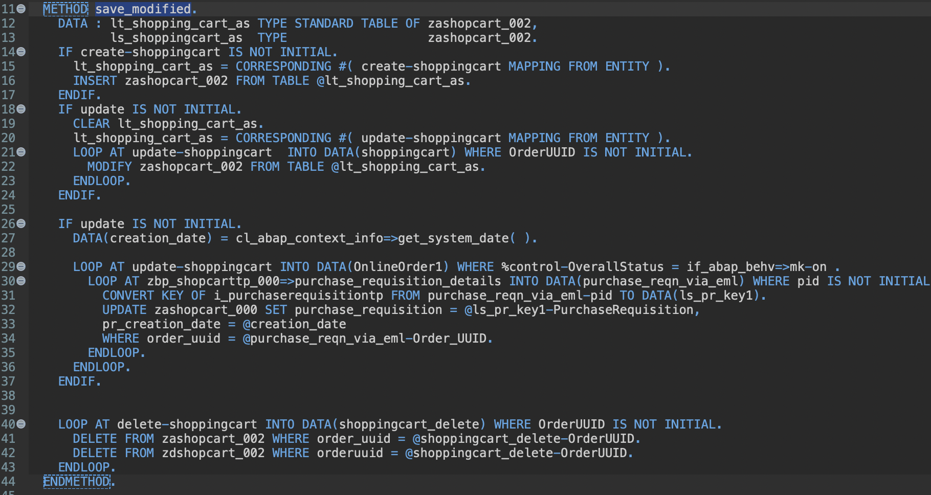
Change Wrapper against the API
Change method save_modified.

Slide 33
Additional task
The whole thing works on a newer SAP system. In the CEGOS system, %pid is not filled and therefore errors occur.
Skip the part in the debugger to be able to test properly.

Slide 34
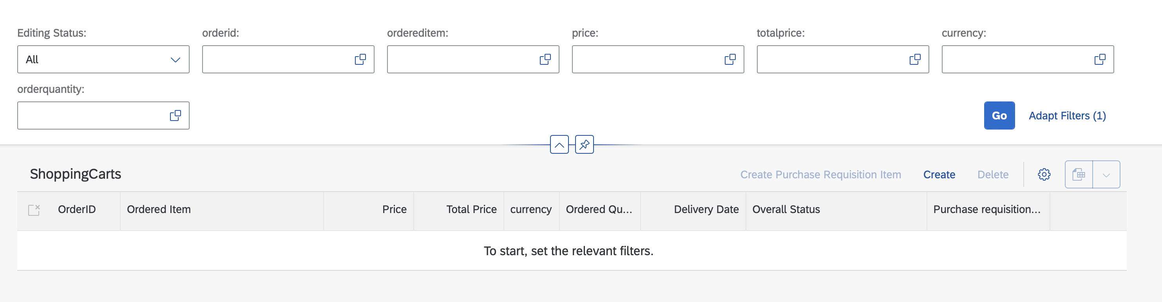
Additional task
Add further Filters with a value help.

Slide 35
Additional task
Rename the elements according to the new implementation

Slide 36
Brainstorming
Wrap up

